Slide 1

Lane Detection On Road
Presented by:
Pathlavath Divya (245621733046)
Gundupalli Thanusha (245621733020)
Gadiraju Sravya Santhoshi (245621733016)
Name of the Guide: Ms.N. Meghana

Slide 2
Abstract
Detecting lanes on roads at night presents unique challenges due to reduced visibility and varying lighting conditions. This paper proposes a novel approach utilizing advanced computer vision techniques, including deep learning-based algorithms, to accurately identify lane markings in low-light environments. By leveraging convolutional neural networks trained on extensive datasets of nighttime driving scenarios, our method achieves robust lane detection performance, enhancing the safety and reliability of autonomous vehicles and assisting human drivers in challenging nighttime conditions.
This project aims to develop a system for real-time lane detection on roads during nighttime conditions. The system will utilize advanced image processing and computer vision techniques to identify and track lane markings in low-light environments. By leveraging algorithms such as edge detection, Hough transforms, and machine learning models, the system will accurately detect lane boundaries and provide real-time feedback to drivers. The project will focus on enhancing road safety by improving lane detection performance in challenging lighting conditions. Through this research, we aim to contribute to the development of intelligent transportation systems that can operate effectively during both day and night.

Slide 3
Requirements
SOFTWARE REQUIREMENTS
HARDWARE REQUIREMENTS
Open CV (Python)
Python
IDE (Integrated Development Environment)
Google Colab
Libraries
NumPy
Cv2
MoviePy
Computer: A capable computer with:
Processor: Modern multi-core processor for real-time video processing (Intel Core i3/i5).
Memory (RAM): Minimum 8 GB RAM.
Storage: Adequate storage space.
Operating System: Windows 11.

Slide 4
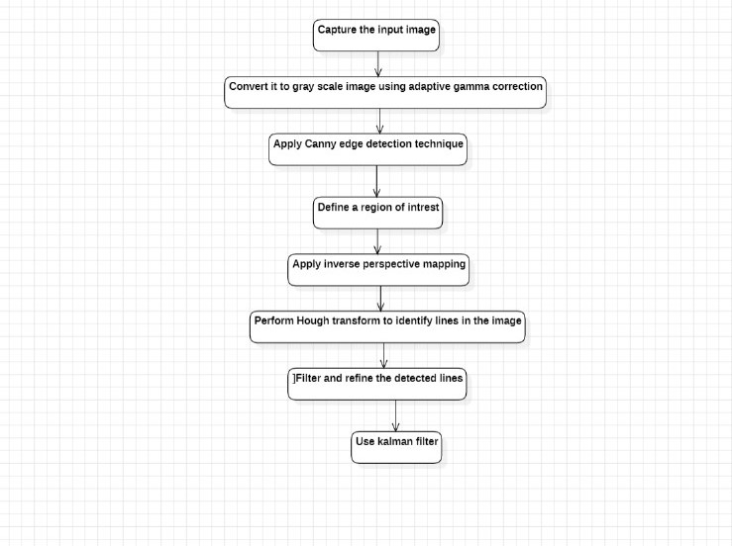
Proposed Methodology

Slide 5
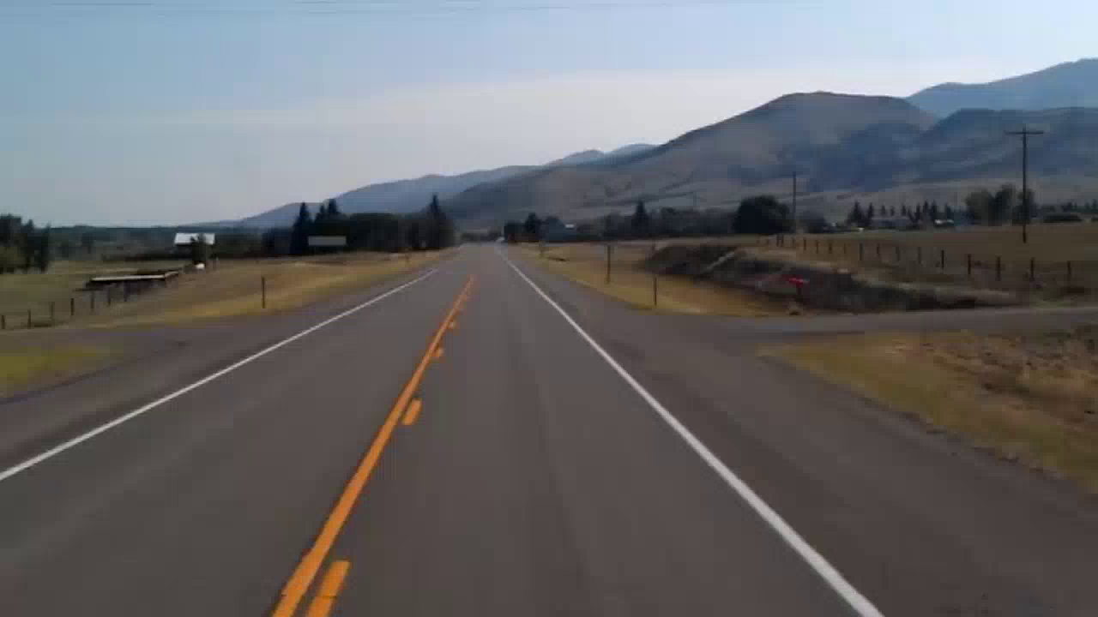
RESULTS
INPUT:
presenting the code...

Slide 6
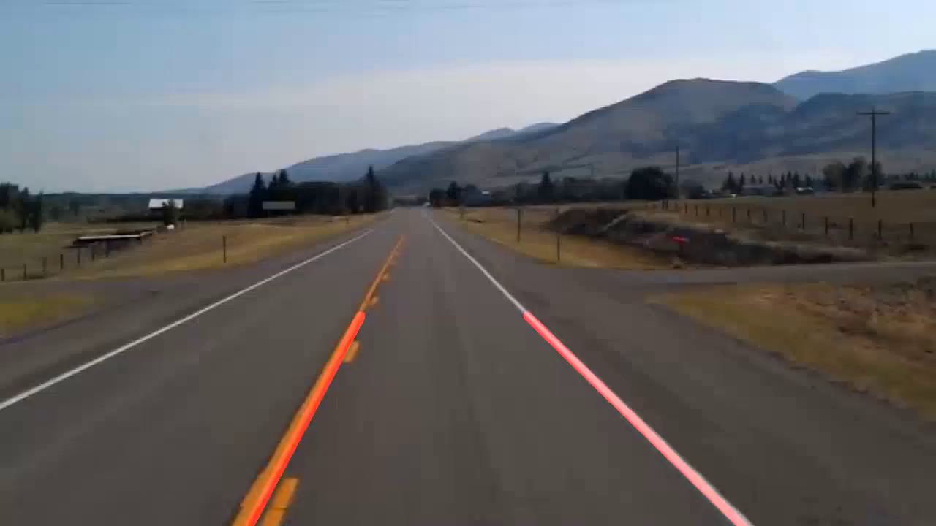
OUTPUT

Slide 7
Conclusion
The lane detection is done by using different image processing algorithms combined in the real-time GPU system. The first is the Kalman Filter. For a given dynamic system, the KF algorithm predicts the future state of the system and updates this with new measurements. Another one is the Hough Transform. In the HT, it identifies lines in an image by transforming them into a parameter space. Next the Adaptive Gamma Correction is applied. The fast Adaptive Gamma Correction algorithm helps to light up the part of the picture where the lane is visible. Then the frame is returned to where the base image is situated. The analysis of video contents represents different traffic scenarios. The true edge of the road should be flagged to predict the movement of the road.

Slide 8

Future Scope
Future research will focus on the use of different and more advanced image processing filters to increase the accuracy of lane detection. It may encompass adaptive filters that automatically respond to varying lighting conditions or those that reduce noise attributed to wetness or reflective road surfaces, thereby hence making the lane detection system even more robust.

Slide 9
References
Manthan Shenoy; Piyush Sonkusle “Real-Time Lane Detection Analysis At Night”,2019 https://www.researchgate.net/publication/337164485_REAL-TIME_LANE_DETECTION_ANALYSIS_AT_NIGHT
Dr. A.K. Madan; Divyansha Jharwal “Road Lane Line Detection Using OpenCV”, 2022 https://www.irjmets.com/uploadedfiles/paper/issue_5_may_2022/23299/final/fin_irjmets1652765861.pdf

